Slide 1
Part I Syllabus – Fundamental Underlying Layers
Week​ | Date​ | Subject​
Week 1 | 9/Jan/2023​ | Introduction: Course Logistics and Internet History​
 | 11/Jan/2023​ | Layered Network Architecture​
Week 2 | 16/Jan/2023​ | Physical-layer Resilience
 | 18/Jan/2023​ | Data Link Layer: Flow Control​
Week 3 | 25/Jan/2023​ (no class on 23/Jan/2023, a holiday​) | Data Link Layer: Error Control​
Week 4 | 30/Jan/2023​ | Local Area Network: Introduction​
 | 01/Feb/2023​ | Local Area Network: Medium Access Control (MAC)​
Week 5 | 06/Feb/2023​ | Local Area Network: Ethernet​
 | 08/Feb/2023​ | Local Area Network: Ethernet Evolutions​
Week 6 | 13/Feb/2023​ | Wireless Local Area Network (WLAN): Overview and 802.11
 | 15/Feb/2023​ | First Part: WLAN’s Multi-Access Reservation Protocol (MARP); Second Part: A Brief Overview of Network Paradigms​
Week 7 | 20/Feb/2023 | Network Paradigms​: Circuit Switching versus Packet Switching
 | 22/Feb/2023 | Mobile Access Networks

Slide 2
Additional Materials
The related content talked today in https://eclass.teicrete.gr/modules/document/file.php/TP326/%CE%98%CE%B5%CF%89%CF%81%CE%AF%CE%B1%20(Lectures)/Computer_Networking_A_Top-Down_Approach.pdf is as follow:
Ethernet: Page 469 – Page 476
Frame: Page 537 – Page 541
You can also find other video materials about
Ethernet
MAC Addresses
Frame Format
https://www.youtube.com/watch?v=MzhiVE6OuQA
https://www.youtube.com/watch?v=FkiTOMn-XGw
https://www.youtube.com/watch?v=jy4kBAzJCKM

Slide 3
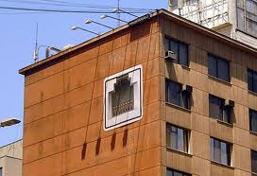
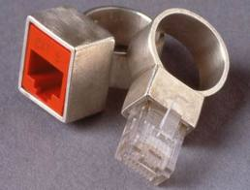
Network Engineer’s World
When we design our house
When we design our wedding rings

Slide 4

SC2008/CZ3006/CE3005 ​ Computer Network
Lecture 7
Wired LAN: Ethernet

Slide 5
Contents
Ethernet Overview
Ethernet Standard
Transmission Media
Physical Layer
Ethernet versions
Ethernet Frame Format
Frame Format
MAC Address
Ethernet MAC Protocol
Minimum Frame Size
Binary Exponential Backoff
Ethernet Evolution
Bridged and Switched Ethernet
Fast, Gigabit and Ten-Gigabit Ethernet
Ethernet Pros and Cons

Slide 6
Ethernet Overview

Slide 7
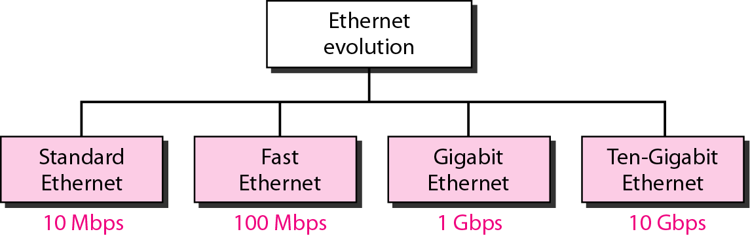
Ethernet: A Brief History
not examinable
History
Invented by Bob Metcalfe and others at Xerox PARC in mid-1970s
Roots in Aloha packet-radio network
Standardized by Xerox, DEC, and Intel in 1978
LAN standards define physical and MAC layers
IEEE 802.3 (CSMA/CD - Ethernet) standard – originally 2Mbps
IEEE 802.3u standard for 100Mbps Ethernet
IEEE 802.3z standard for 1,000Mbps Ethernet

Slide 8
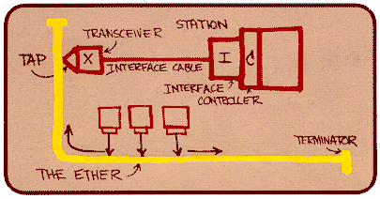
Ethernet Standard: Physical Layer
not examinable
802.3 standard defines both physical and MAC layer details
MAC Protocol: CSMA/CD
Physical layer:
Metcalfe’s original
Ethernet Sketch: The idea was first documented in a memo that Metcalfe wrote on May 22, 1973, where he named it after the disproven luminiferous ether as an "omnipresent, completely-passive medium for the propagation of electromagnetic waves".

Slide 9
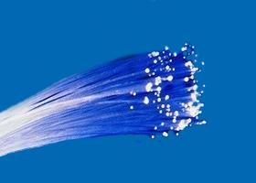
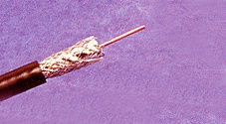
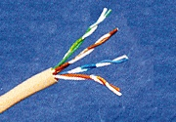
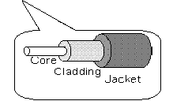
Ethernet Transmission Media
not examinable
Coaxial cable
Thick coax: Used by original Ethernet (bus topology)
Thin coax: More flexible, but shorter network span
Twisted pair: For star topology, used with a hub, most commonly used
Optical fiber: Expensive, Fragile, Difficult to handle, but high data rate. Used in backbone.
optical fiber
coax
twisted pair

Slide 10
802.3 Physical Layer Configurations
not examinable
Physical layer configurations are specified in three parts
Data rate (10, 100, 1,000)
10, 100, 1,000Mbps
Signaling method (base, broad)
Baseband: digital signaling
Broadband: analog signaling
Cabling (2, 5, T, F, S, L)
2 – 200m thin coax
5 – 500m thick coax (original Ethernet cabling)
T – Twisted pair
F – Optical fiber
S – Short wave laser over multimode fiber
L – Long wave laser over single mode fiber

Slide 11
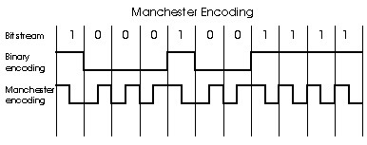
Baseband Manchester Encoding
not examinable
Baseband here means that no carrier is modulated; instead bits are encoded using Manchester encoding and transmitted directly by modifying voltage of a DC signal.
Manchester encoding ensures that a voltage transition occurs in each bit time which helps receiver in clock synchronization.

Slide 12
Ethernet Versions
not examinable
Ethernet comes with several versions based on its network configurations. Important ones are:
10BASE-5 (Original Ethernet)
10BASE-2 (Cheapernet)
10BASE-T (Star topology using a hub)
Others (eg 10BASE-FL, 10BASE-FP, etc)
Notation:
10 BASE 5
Medium segment length (in 100m unit) or type. Possible options are: 5,2,T,F,etc
10 Mbps
Signaling mode,
Base or Broad

Slide 13
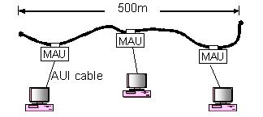
10BASE-5
not examinable
repeater
may add up to 4 more segments
Original Ethernet design, thick coax (50ohm) is used
Each segment is of 500m long (max)
Four repeaters (max) can be used to connect up to 5 segments
AUI cable connecting the PC and the thick coax cannot be longer than 50m

Slide 14
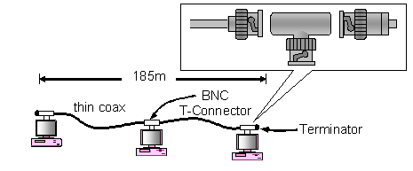
10BASE-2
not examinable
Called cheapernet because it is cheap to deploy. Thin coax is used
Each segment is of 185m long (max), min cable length between two computers is 0.5m, max 30 nodes
Up to 4 repeaters, (so entire network cable=925m)

Slide 15
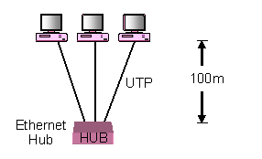
10BASE-T
not examinable
‘T’ in 10BASE-T stands for Twisted pairs (UTP: unshielded twisted pairs). At least two pairs of wires.
Most popular Ethernet option
Cable length between a hub & a computer = 100m

Slide 16
Ethernet Frame Format

Slide 17
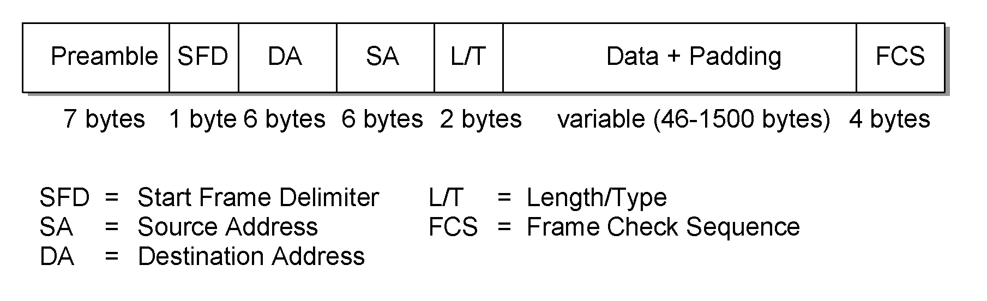
Ethernet Frame Format
Ethernet frame
Preamble & SFD: 7 bytes with the pattern 10101010 followed by one byte with the pattern 10101011; used for synchronizing receiver to sender clock (clocks are never exact)
Pad field allows additional dummy data to be included to a frame for min. frame size requirement.
Frame Check Sequence field enables error detection using CRC. It covers between Source Address and Pad fields.

Slide 18
Ethernet Frames
Preamble is a sequence of 7 bytes, each set to “10101010”
Used to synchronize receiver before actual data is sent
Addresses
unique, 48-bit unicast address assigned to each adapter
example: 08:00:e4:b1:02:a2
Each manufacturer gets their own address range
broadcast: all 1s
multicast: first bit (from right) of the first byte is 1
unicast: first bit (from right) of the first byte is 0
Type field is a demultiplexing key used to determine which higher level protocol the frame should be delivered to
Body can contain up to 1500 bytes of data

Slide 19
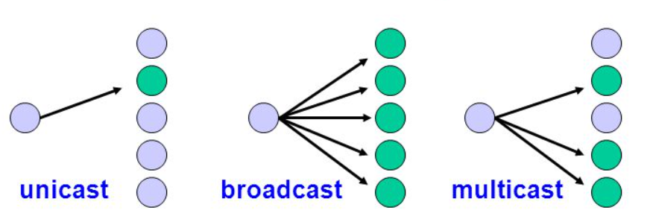
Broadcast, Multicast, Unicast
Broadcast: One to All
Multicast: One to Many
Unicast: One to One

Slide 20
MAC Address Examples
Question
Define the type of the following destination addresses:
a. 4A:30:10:21:10:1A b. 47:20:1B:2E:08:EE
c. FF:FF:FF:FF:FF:FF
Solution
To find the type of the address, we need to look at the second hexadecimal digit from the left. If it is even, the address is unicast. If it is odd, the address is multicast. If all digits are F’s, the address is broadcast. Therefore, we have the following:
a. This is a unicast address because A in binary is 1010.
b. This is a multicast address because 7 in binary is 0111.
c. This is a broadcast address because all digits are F’s.

Slide 21
Ethernet’s MAC

Slide 22
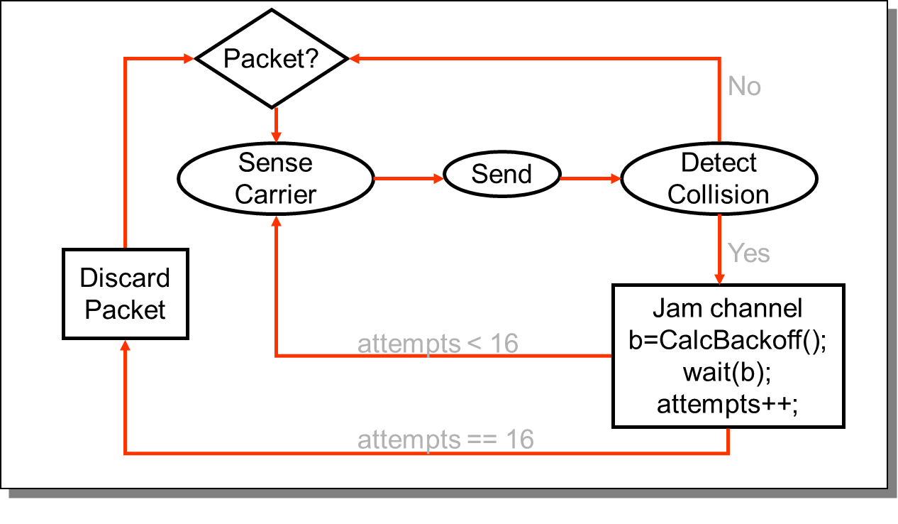
Ethernet’s MAC Algorithm
Ethernet uses CSMA/CD
Listens to line before/during sending
If line is idle (no carrier sensed)
Send packet immediately
Upper bound message size of 1500 bytes
Must wait 9.6us between back-to-back frames
If line is busy (carrier sensed)
Wait until idle and transmit packet immediately
called 1-persistent sending
If collision detected
Stop sending and jam signal
Try again later

Slide 23
Frame Collisions
Collisions are caused when two adaptors transmit at the same time (adaptors sense collision based on voltage differences)
Both found line to be idle
Both had been waiting for a busy line to become idle
A starts at
time 0
A
B
Message almost
there at time T when
B starts – collision!
A
B
How can we be sure A knows about the collision?

Slide 24

Ethernet Minimum Frame Size
So, a sender must keep its transmission until it is sure that there are no other transmissions on the medium it is not aware of before it ends its transmission.
But then how long to keep its transmission?
A transmission requires an end-to-end signal propagation time (τ) to reach all stations (the longest), then a potential collision requires τ unit of time to return to the sender.
So the frame transmission ≥ 2τ; i.e., signal round trip time.
A
…
B
τ
+τ

Slide 25
Collision Detection
How can A know that a collision has taken place?
Must have a mechanism to ensure retransmission on collision
A’s message reaches B at time T
B’s message reaches A at time 2T
So, A must still be transmitting at 2T
IEEE 802.3 specifies max value of 2T to be 51.2us
This relates to maximum distance of 2500m between hosts
At 10Mbps it takes 0.1us to transmit one bit so 512 bits (64B) take 51.2us to send
So, Ethernet frames must be at least 64B long
14B header, 46B data, 4B CRC
Padding is used if data is less than 46B
Send jamming signal after collision is detected to ensure all hosts see collision
48 bit signal

Slide 26

Ethernet: Jam Signals
In the previous slide, B’s transmission cannot be too brief, otherwise A might not see the collision
To avoid this, a station is required to transmit a jam sequence (32 to 48 bits long) after it has detected a collision. This will make the collision more obvious.
1. A senses the medium idle and starts transmission
A
B
C
2. C starts a transmission
3. C detects collision
5. A detects collision, stops transmitting.
6. A sends jam signal
4. C transmits jam signal
Time

Slide 27

Binary Exponential Backoff (BEB)
What should stations do when a collision is detected?
Discard the packet and let upper layer protocols do the retransmission as in Aloha, slotted Aloha, and CSMA (☠ NO!!!!!). But how?
They can choose a future slot randomly to retransmit based on Binary Exponential Backoff (BEB).
Delay time is selected using binary exponential backoff
1st time: choose K from {0,1} then delay = K * 51.2us
2nd time: choose K from {0,1,2,3} then delay = K * 51.2us
n^{th} time: delay = K x 51.2us, for K from {0,1,… 2^{n} – 1}
Note max value for K = 1023
give up after several tries (usually 16)
Report transmit error to host
If delay were not random, then there is a chance that sources would retransmit in lock step
Why not just choose from small set for K
This works fine for a small number of hosts
Large number of nodes would result in more collisions

Slide 28
BEB: Example
Channel
0
1
0
1
2
3
A
B
1st Retrial
P(Collision) = P(A&B=0) + P(A&B=1)
P(A&B=0) = P(A=0)*P(B=0)
= 0.5*0.5 = 0.25
P(Collision) = 0.25 +0.25 =0.5
2nd Retrial
P(Collision) = P(A&B=0) + P(A&B=1)
+ P(A&B=2) + P(A&B=3)
P(A&B=0) = P(A=0) * P(B=0)
= 0.25 * 0.25 = 0.0625
P(Collision) = 4*0.0625 = 0.25

Slide 29
MAC Algorithm from Receiver
Senders handle all access control
Receivers simply read frames with acceptable address
Address to host
Address to broadcast
Address to multicast to which host belongs
All frames if host is in promiscuous mode

Slide 30
Ethernet Evolutions

Slide 31
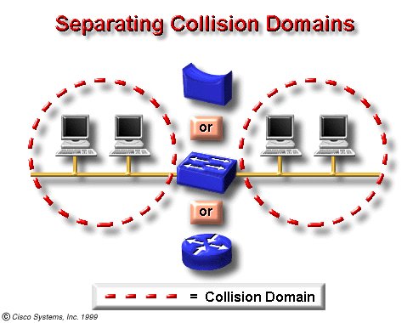
Collision Domain
Read https://www.geeksforgeeks.org/network-devices-hub-repeater-bridge-switch-router-gateways/
Network region in which collisions are propagated.
Repeaters (2-port) and hubs (multi-port) propagate collisions.
Bridges (2-port), switches (multi-port) and routers do not.
Collision frequency can be kept low by breaking the network into segments bounded by:
bridges
switches
routers

Slide 32
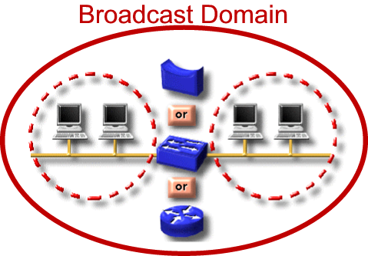
Broadcast Domain
Network region in which broadcast frames are propagated.
Repeaters, hubs, bridges, & switches propagate broadcasts. (Layer 2)
Routers either do or don’t, depending on their configuration.(Layer 3)
Broadcasts are necessary for network function.
Some devices and protocols produce lots of broadcasts; avoid them.
Broadcast frequency can be kept manageable by limiting the LAN size.
LANs can then be cross-connected by routers to make a larger internetwork.

Slide 33
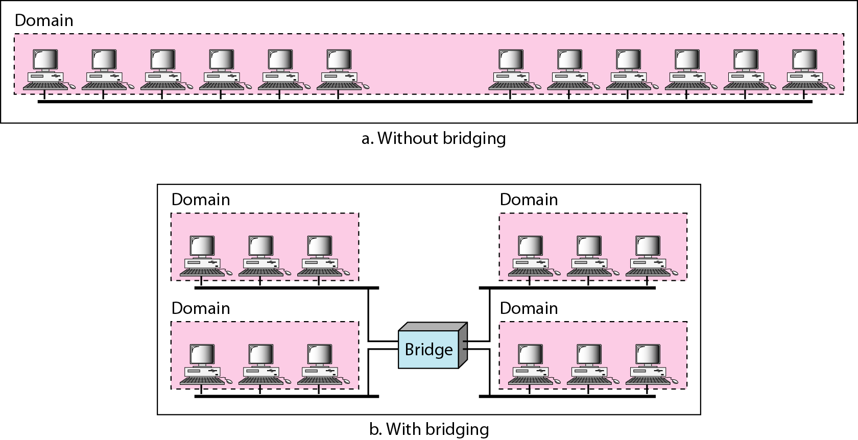
Bridged Ethernet

Slide 34


Shared versus Switched
hub
switch
...
...
...
destination
sender
destination
A repeater (or a hub) forwards the received signals to all output ports except the incoming port.
A collision occurs when two computers transmit at the same time. In this case, the channel carries no useful information.
A switch (or a switching hub) forwards the received signals only to the destination.
When two transmissions arrive at the switch at the same time, they will be stored in different buffers so that their frames can be forwarded later. No collision is resulted.

Slide 35
Switched Ethernet
not examinable
Switches forward and filter frames based on LAN addresses
It’s not a bus or a router (simple forwarding tables are maintained)
Very scalable
Options for many interfaces
Full duplex operation (send/receive frames simultaneously)
Connect two or more “segments” by copying data frames between them
Switches only copy data when needed
key difference from repeaters
Higher link bandwidth
Collisions are completely avoided
Much greater aggregate bandwidth
Separate segments can send at once

Slide 36
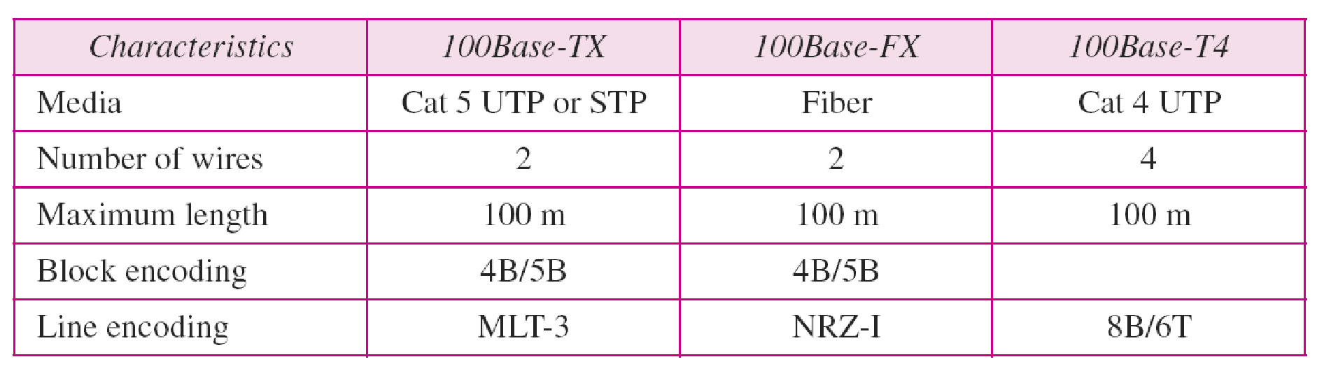
Fast Ethernet (FE)
not examinable
Fast Ethernet (100Mbps) has technology very similar to 10Mbps Ethernet
Uses different physical layer encoding (4B5B)
Many NIC’s are 10/100 capable
Can be used at either speed
Summary of Fast Ethernet Implementation

Slide 37
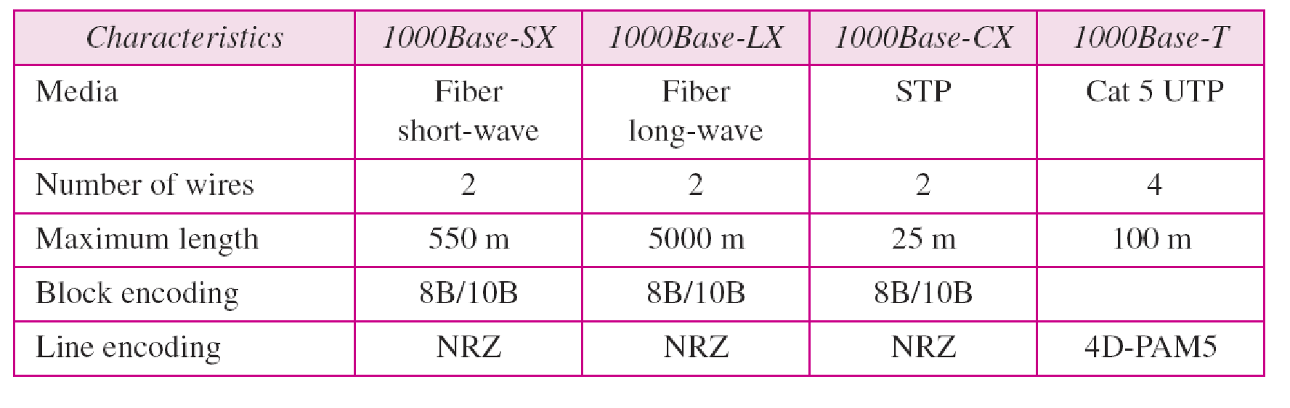
Gigabit Ethernet (GbE)
not examinable
Gigabit Ethernet (1,000Mbps)
Compatible with lower speeds
Uses standard framing and CSMA/CD algorithm
Distances are severely limited
Used for backbones and inter-router connectivity
Cost competitive

Slide 38
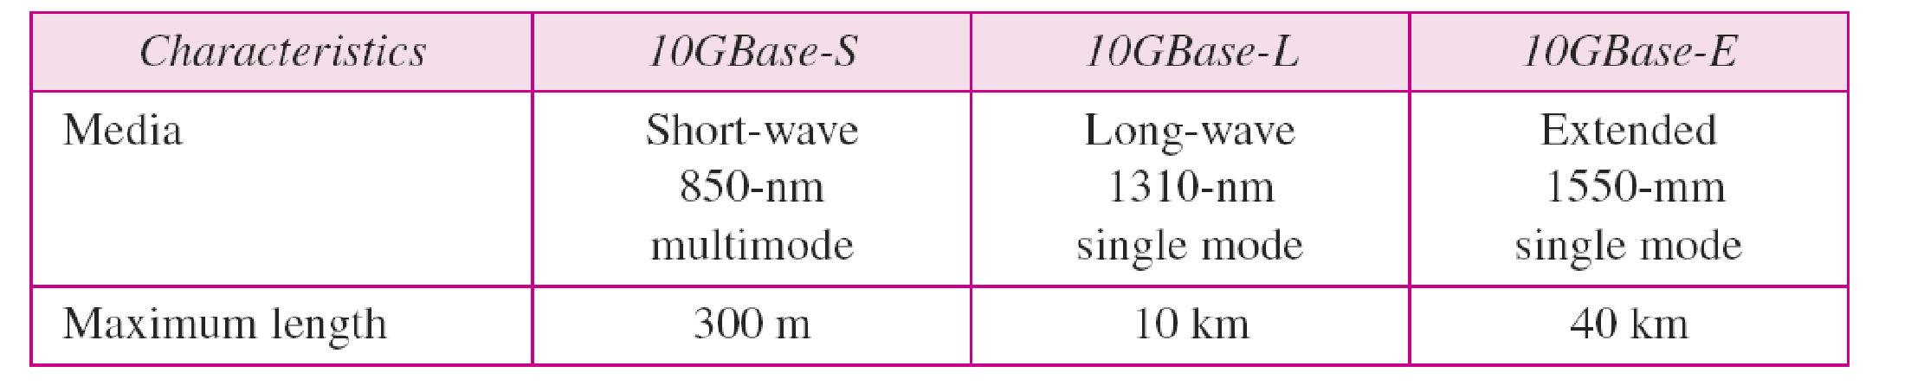
Ten-Gigabit Ethernet (10GbE)
not examinable
Ten-Gigabit Ethernet (10Gbps)
Defined by IEEE 802.3ae-2002
Higher-grade copper cables required: cat 6a or Class F/Cat 7 cables for links up to 100m

Slide 39
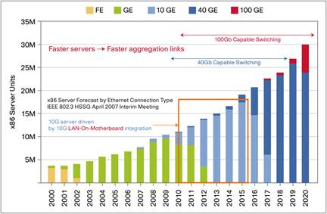
Ethernet Adoption Trends
not examinable
http://www.cisco.com/c/en/us/products/collateral/switches/catalyst-6500-series-switches/white_paper_c11-696667.html

Slide 40
Experiences with Ethernet
not examinable
Ethernets work best under light loads
Utilization over 30% is considered heavy
Network capacity is wasted by collisions
Most networks are limited to about 200 hosts
Specification allows for up to 1024
Most networks are much shorter
5 to 10 microsecond RTT
Transport level flow control helps reduce load (number of back to back packets)
Ethernet is inexpensive, fast and easy to administer!

Slide 41
Ethernet Problems
not examinable
Ethernet’s peak utilization is pretty low (like Aloha)
Peak throughput worsens with
More hosts
More collisions
Longer links
Collisions take longer to observe, more wasted bandwidth
Efficiency can be improved by avoiding the above conditions

Slide 42
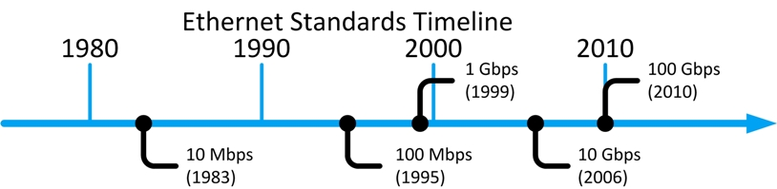
Why did Ethernet win?
not examinable
There are many LAN protocols (ARCNET, Token ring, AppleTalk, etc)
Price
Performance
Availability
Ease of use
Scalability

Slide 43
Learning Objectives
Ethernet Overview
Read Ethernet versions
Ethernet Frame Format
Understand MAC address: unicast/broadcast
Ethernet MAC Protocols
Calculate minimum frame size
Calculate collision rate under BEB scheme
Ethernet Evolutions
Count collision/broadcast domains
FE/GbE/10GbE
not examinable
examinable
examinable
examinable
examinable
not examinable

Slide 44
Practice
1. Go to www.menti.com and use the code 6743 9603
2. Go to www.menti.com and use the code 4659 5518

